Slide 1

Face Recognition based Attendance System
Prepared By:-
Md. Tauhid Alam (18bcs6588)
Bibek Rawat (18bcs6728)
Shreyansh Raut (18bcs1703)
Subham sah (18bcs6537)
Project Supervisor:
Dr. Rajendra kumar
DISCOVER . LEARN . EMPOWER

Slide 2
Problem Statement(Project Need)
5-10 mins is wasted for taking attendance.
Statistical data is hard to compute and analyze.
False attendance and proxy.

Slide 3
Project Objectives
Processing which occurs before detection involving face detection and alignment and later recognition is done using the feature extraction and matching steps.
Face Detection
Feature Extraction
Face Recognition

Slide 4
Individual Contribution
Work | Done By:
Coding | Bibek Rawat Shubham Sah
Designing | Md. Tauhid Alam
Database | Shreyansh Raut

Slide 5
Introduction To Project
Attendance in a large class room is hard to be handled by traditional marking system
Solution: Using Face Recognition, an Image Processing application.
Machine Learning Algorithms used in this project to train and test model.

Slide 6
Methodology Used
Face Recognition, an Image Processing application being used.
Machine Learning Algorithms used in this project to train and test model.
Trained the model on data collected from the student during registration.

Slide 7
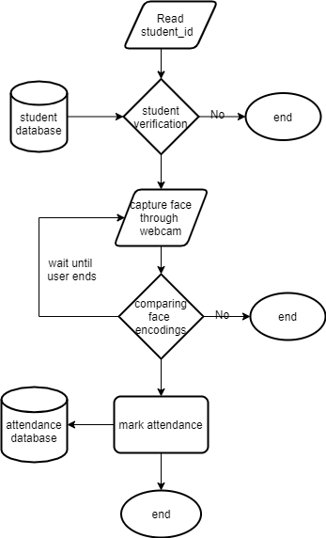
FLOW CHART

Slide 8
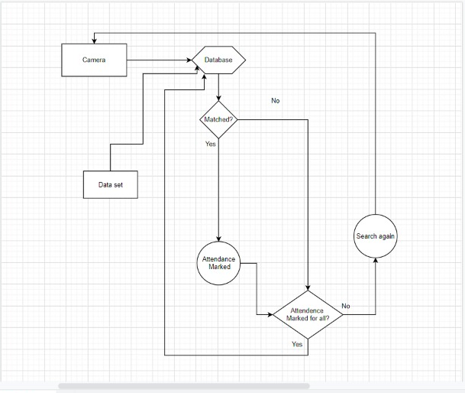
Data Flow Diagram

Slide 9
Technologies Used
Language: Python
Software: Pycharm
Microsoft Cognitive Face API
Dlib library

Slide 10
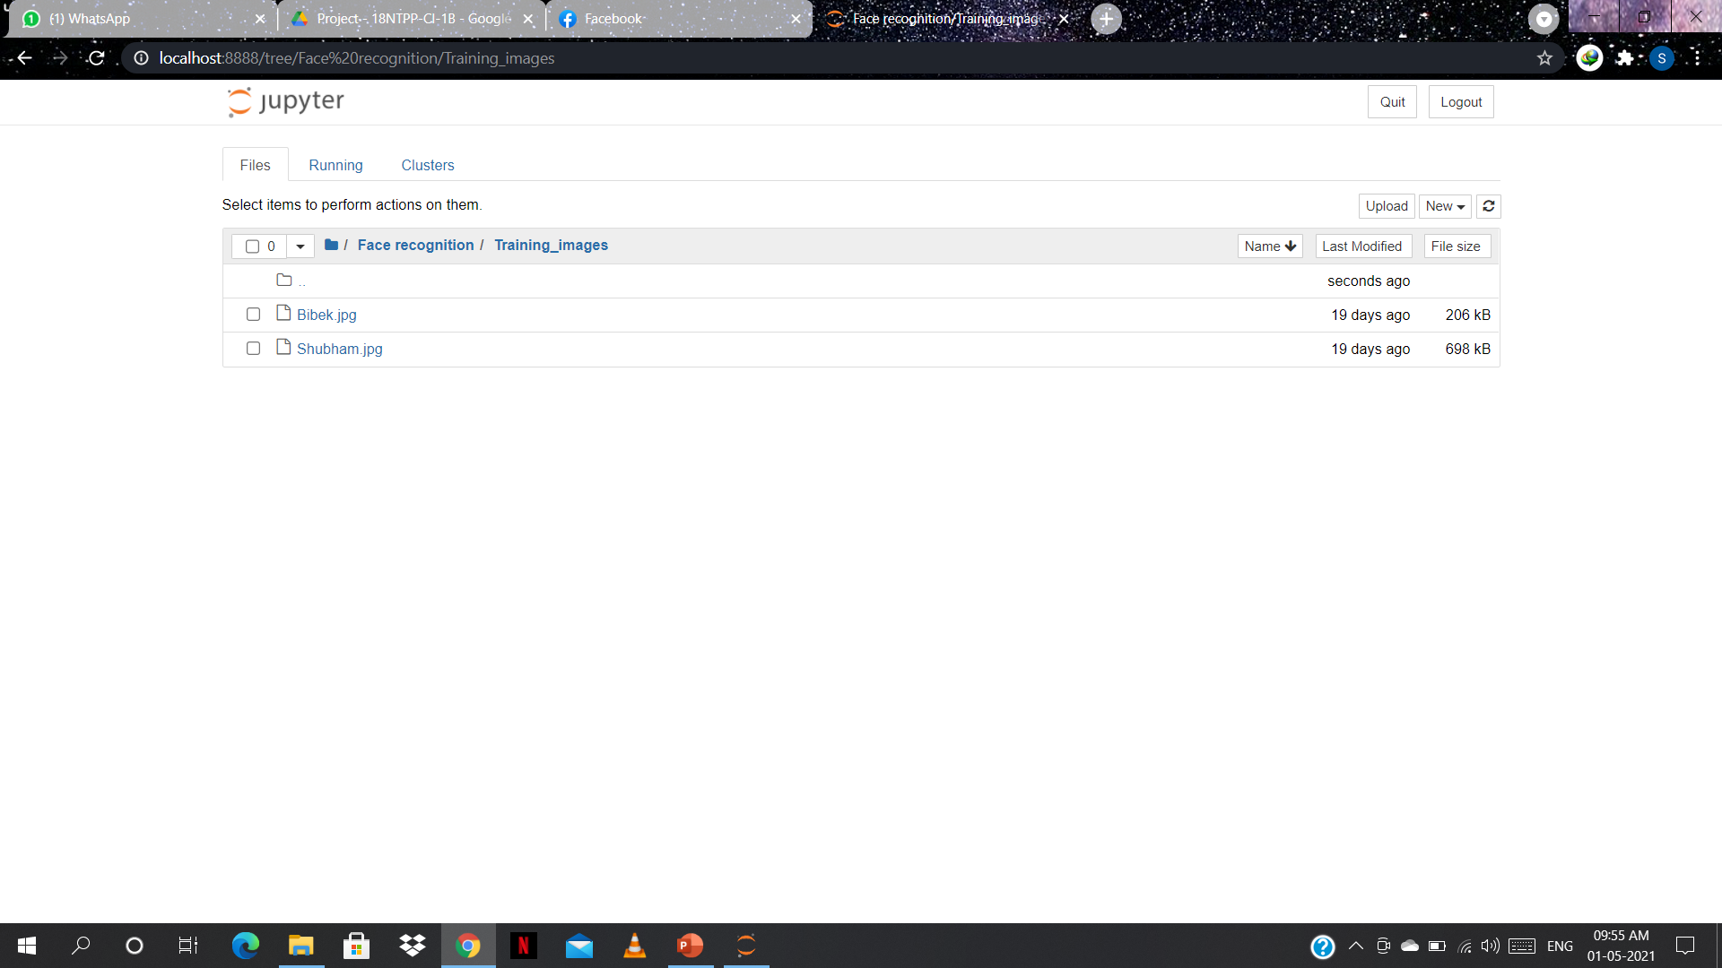
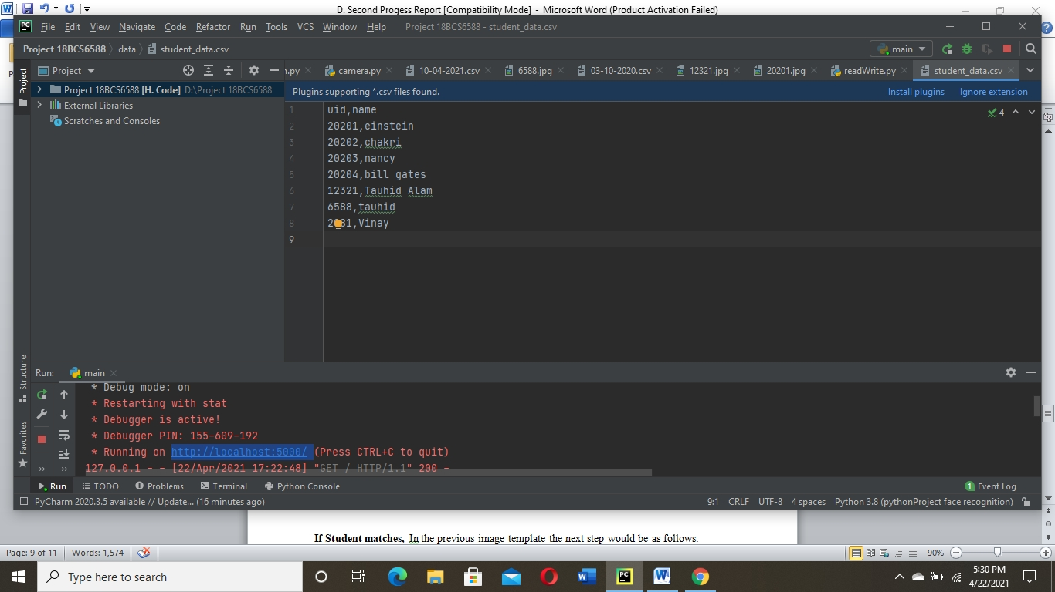
Student data and Training image
The following image is stored on the uid ‘20205’ and the remaining data is shown.

Slide 11
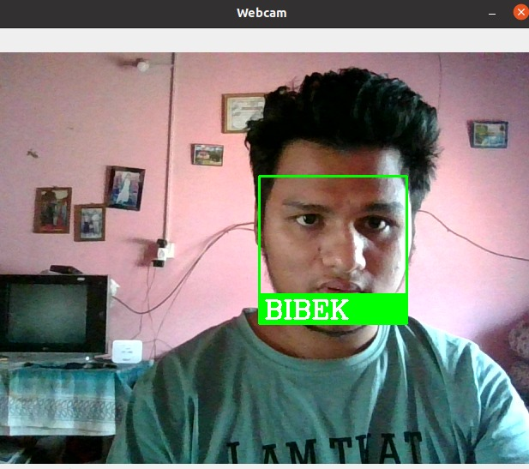
Implementation: If Student matched

Slide 12
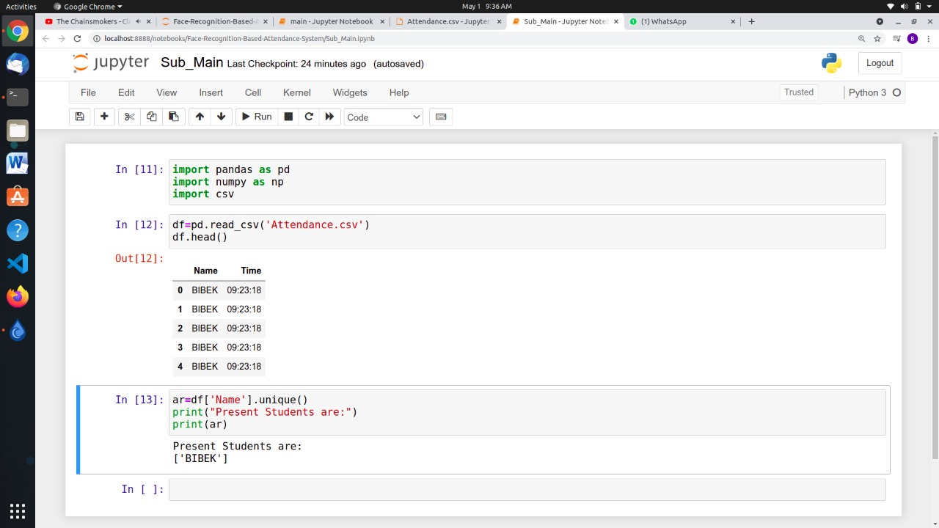
Output

Slide 13
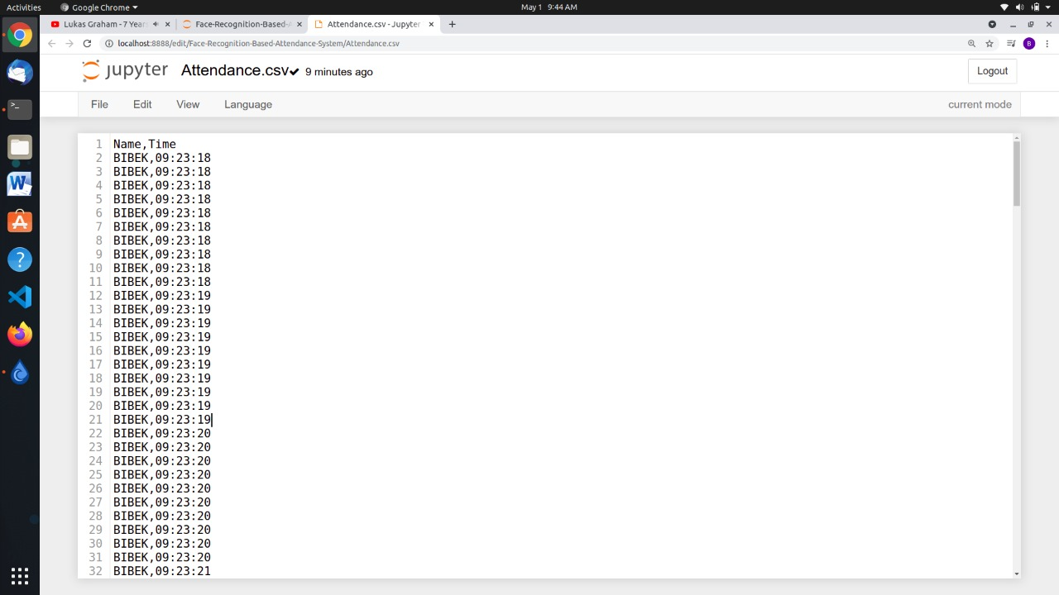
Csv file after marking

Slide 14
Comparisons
In the table below we will compare three most commonly used face recognition methods,
 | LBP | HAAR | HOG
TPR% | 60.37 | 78.23 | 92.68
FNR% | 39.65 | 21.76 | 7.31
The above table is based on a research paper with DOI: 10.1109/SSD.2019.8893214
here we compare LBP (Local Binary Pattern), HAAR (Haar-like cascade),
HOG (Histogram of Oriented Gradients) base on two factors
TPR (True Positive Rate) and FNR (False Negative Rate) and from
the table we can easily say that HOG method way more accurate than others.
The model is working with high Accuracy during optimal and medium light
conditions and in different angles. While, during minimal light conditions the model
is a bit struggling.

Slide 15
Project Outcome
OUTCOME | STATUS(Communicated/ Accepted/Published/App Hosted)
Software | Completed
IEEE Report | Completed

Slide 16
Further Innovations
Auto Alert for teachers and students
Automation of camera
Special optimization for student sitting at the back of the class

Slide 17
References
OpenCV Documentation http://docs.opencv.org/2.4/modules/contrib/doc/facerec/facerec_tutorial.html
Dlib Documentation http://dlib.net/imaging.html
Microsoft Face API http://dlib.net/imaging.html

Slide 18
Thank You

